Slide 1
Music Recommendation System

Slide 2
PROBLEM STATEMENT
Spotify offers a web API that allows developers to get audio aspects and metadata about songs, such as the song's popularity, tempo, loudness, key, and release year. We can utilise this information to create music recommendation systems that provide consumers recommendations based on both the audio and metadata of the songs they've listened to.
In this project, we’ve worked on a content-based music recommendation engine using a Spotify song dataset and Spotify, a Python library for Spotify.

Slide 3
OBJECTIVES
Spotify has a web API that developers can use to retrieve audio features and metadata about songs such as the song’s popularity, tempo, loudness, key, and the year in which it was released. We can use this data to build music recommendation systems that recommend songs to users based on both the audio features and the metadata of the songs that they have listened to.

Slide 4






SOFTWARE REQUIREMENTS
Spotify Dataset
Jupyter Notebook
Libraries:
Numpy
Pandas
Matplotlib
Pyplot
Seaborn
Spotify

Slide 5
DATASET DESCRIPTION
We had used the Spotify Dataset, which is publicly available on Kaggle and contains metadata and audio features for over 170,000 different songs. I used three data files from this dataset. The first one contains data for individual songs while the next two files contain the data grouped the genres and years in which the songs were released.

Slide 6
DATA PRE-PROCESSING
We have included the column metadata below that was generated by calling the Pandas info function for each data frame.
This dataset is extremely useful and can be used for a wide range of tasks. Before building a recommendation system, I decided to create some visualizations to better understand the data and the trends in music over the last 100 years.

Slide 7
ALGORITHMS
The algorithms that are used are:
K-means clustering algorithm
t-Distributed Stochastic Neighbor Embedding algorithm
Principal Component Analysis

Slide 8
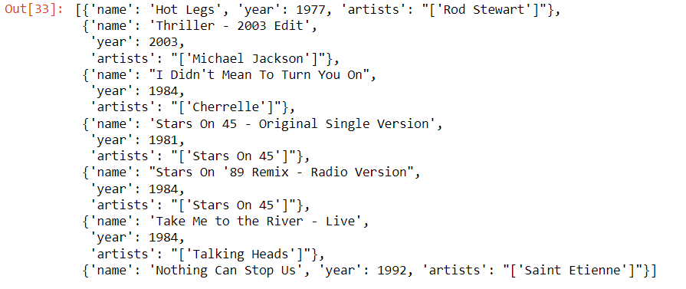
INPUT
OUTPUT
Three datasets:
Data.csv
Data_by_genres.csv
Data_by_year.csv

Slide 9
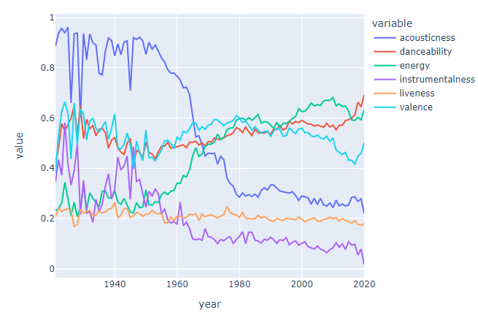
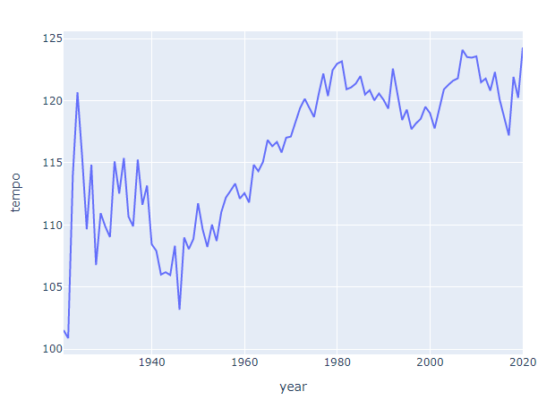
VISUALIZATION

Slide 10
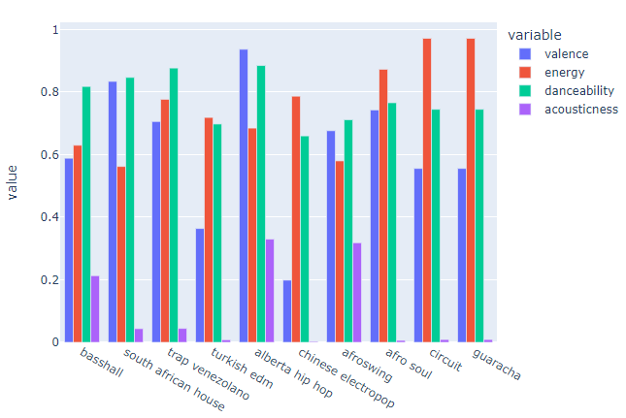
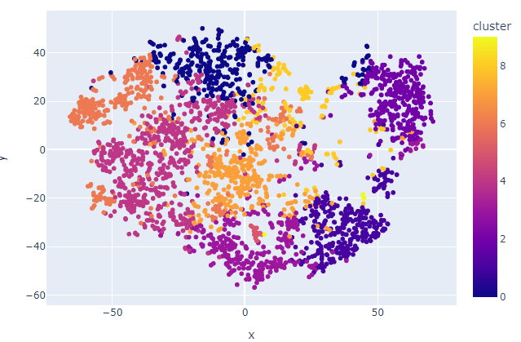
VISUALIZATION

Slide 11
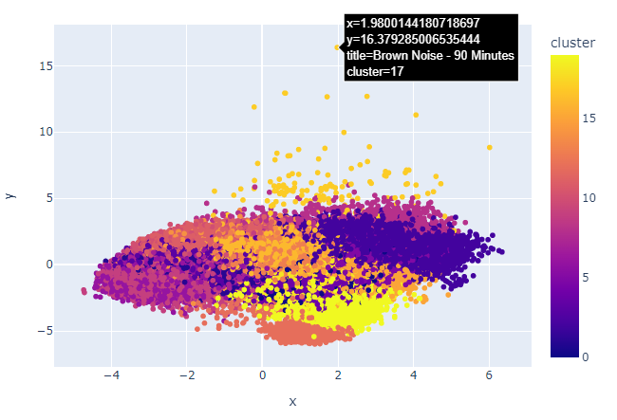
VISUALIZATION

Slide 12
CONCLUSION
The top song on the list is by Rod Stewart, who like Michael Jackson, rose to fame in the 1980s. The list also contains a 2003 edit of Michael Jackson’s Thriller, which makes sense given that the user has already heard the original 1982 version of this song. The list also includes pop and rock songs from 1980s groups such as Stars On 45 and Talking Heads.
Spotify keeps track of metadata and audio features for songs that we can use to build music recommendation systems.

Slide 13
REFERENCES
https://developer.spotify.com/documentation/web-api/
https://www.sciencedirect.com/science/article/pii/S1877050919310646#:~:text=By%20using%20music%20recommender%20system,that%20has%20been%20heard%20previously.
https://medium.com/@briansrebrenik/introduction-to-music-recommendation-and-machine-learning-310c4841b01d
https://www.kaggle.com/

Slide 14
THANK YOU!

